Slide 1
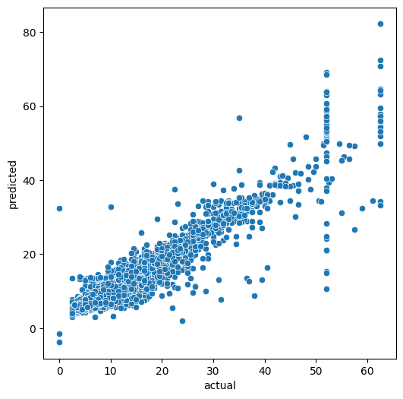
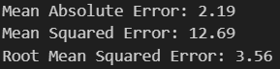
New York City TLC Project . Linear regression model. Executive summary
Execurive summary report
New York City Taxi and Limousine Commission (TLC) requested to build a regression model that predicts taxi cab fares before each ride. based on distance, time of day, and any additional variables we find necessary. At this stage, Data Team should perform Exploratory Data Analysis and provide detailed inside about findings
At this stage Data Team need to compute descriptive statistics and create a regression model from the New York City TLC dataset
After cleaning data and transforming some values (outliers) , Data Team thoroughly analysis all variables included in the data set and make assumptions if that variables will be available for prediction.
As a best choice for model, multiple linear regression model was chosen. All assumptions for dependent variable and included independent variables were checked.
Model showed good results with Adj. R-squared = 0.869
With keeping all other parameters the same, the increasing mean trip duration on 1 minute will lead to increasing fare amount by 1.63$, meanwhile if we keep all other parameters and increase mean distance by 1 mile, the fare cost will increase by 7.27$
Although The model provides a generally strong and reliable fare prediction that can be used as a baseline It is suggesting to continue working on the model and evaluate the model to get even better performance

